Slide 1
smartTrade: STConnect 6.0.x.x Use cases

Slide 2
Agenda
Authentication
Market data
Orders
Queries
Request For Quote
Failover

Slide 3
1. Authentication
Authentication strategies
Authenticated messages
Sample

Slide 4
1.1 Authentication strategies
smartTrade offers two types of authentication
smartTrade authentication
A Logon request is made to STTP
STTP authentication provider authenticates the user
A userId is sent back in the LogonResponse
External authentication
A userId is provided by an external authentication system

Slide 5
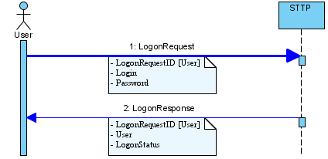
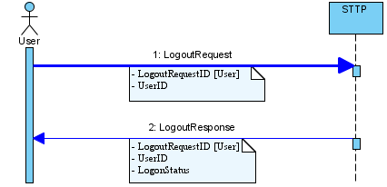
1.1 Authentication strategies
smartTrade Authentication:
UseCase1_Authentication.java

Slide 6
1.2 Authenticated messages
An authenticated message is a message with a userId
All the messages have a MessageRouting
The MessageRouting’s senderSubId is the authenticated userId
Example with a Logout message
// creating Logout message final
Logout msg = STMessageFactory.newLogout(LogoutRequestID.createLogoutRequestID(UID.next()));
// Add SenderSubID to the message
msg.getMessageRouting().setSenderSubID(userID);
// logout user
stconnect.sendLogout(msg);

Slide 7
1.3 Authentication sample Logon
Send a Logon request
React to the LogonResponse message
protected void login() {
try {
// creating Logon message
final Logon msg = STMessageFactory.newLogon(LogonRequestID.createLogonRequestID(UID.next()), Login.createLogin(login),
Password.createPassword(pwd));
msg.setIsForceIfAlreadyConnected(true);
// login user
stconnect.sendLogon(msg);
final LogonResponse response = waitForLogon.exchange(null, 2, TimeUnit.SECONDS);
// retrieving user session id. It is needed for any message sent to STTP
if (checkLoginSuccessfull(response)) {
userID = response.getUser().getUserID();
}
} catch (final Exception e) {
e.printStackTrace();
}
}
@Override
public void onLogonResponse(LogonResponse message) {
try {
waitForLogon.exchange(message);
} catch (final InterruptedException e) {
e.printStackTrace();
}
}

Slide 8
1.3 Authentication sample Logout
Send a Logout request
React to the LogoutResponse message
protected void logout() {
try {
// creating Logout message
final Logout msg = STMessageFactory.newLogout(LogoutRequestID.createLogoutRequestID(UID.next()));
// Add SenderSubID to the message
msg.getMessageRouting().setSenderSubID(userID);
// logout user
stconnect.sendLogout(msg);
final LogoutResponse logoutResponse = waitForLogout.exchange(null, 5, TimeUnit.SECONDS);
if (logoutResponse.getLogoutStatus().equals(LogoutStatus.DISCONNECTED())) {
log.info(login + " successfully logged out");
} else {
log.warn(login + " failed to log out");
}
} catch (final Exception e) {
e.printStackTrace();
}
}
@Override
public void onLogonResponse(LogonResponse message) {
try {
waitForLogout.exchange(message);
} catch (final InterruptedException e) {
e.printStackTrace();
}
}

Slide 9
2. Market data
Workflow
Messages
Market Data subscription
Market Data subscription cancellation
Market Data report
Market Data snapshot
Exercise

Slide 10
2.1 Market data workflow
In order to receive MarketDataSnapshot on an instrument, a subscription must be sent: MarketDataRequest
A subscription can be amended by resending a MarketDataRequest with the same id or cancelled with a CancelMarketDataRequest
Once subscribed, STTP sends MarketDataSnapshot that contains the aggregated bids and offers of the subscribed instrument, as well as information about its status (indicative or not)
STTP also sends a MarketDataReport when the request is cancelled or when there is a problem with the subscription (with a status and reason)
Incremental model supported

Slide 11
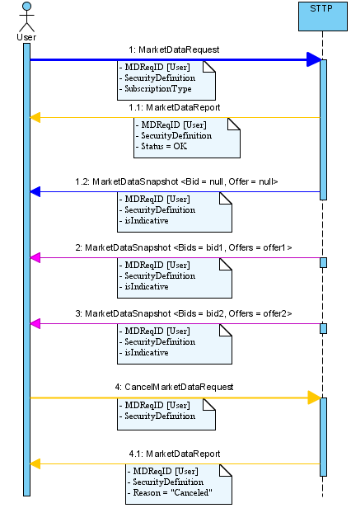
2.1 Market data workflow
UseCase2_MarketData.java

Slide 12
2.2 Market data messages : subscription
Market data subscription
Done with a MarketDataRequest message
Security definition
MDRequestId
A distribution
Market depth
Sender id (authentication)
Flag to enable/disable feedbacks (optional)
Flag to enable/disable the market data conflation (optional)
Subscription type (incremental/full)
Notes:
Feedback -> to receive the MDS notification on the MessageListener (not mandatory as we may want to concentrate on trade flow and publish the market data on a bus or another flow)
Conflation -> to batch the MDS and send them every n seconds ( only applies to the ‘non important’ MDS) to lower the flow of messages

Slide 13
2.2 Market data messages : subscription sample
public void subscribeToMarketData() {
try {
// we are subscribing to market data: 2 steps
// 1. we send a request to the gateway for one instrument:
// therefore the gateway will begin to contribute on the instrument
// 1.1 MarketDataRequest message creation
final MarketDataRequest mdr = STMessageFactory.newMarketDataRequest(instrument);
mdr.setMDReqID(mdReqID);
mdr.setMarketDepth(MarketDepth.createMarketDepth(10));
final Distrib distrib = STMessageFactory.newDistrib();
distrib.addEndPoint(STMessageFactory.newDistribEndPoint(counterPartID, EndPointType.MANUAL()));
mdr.setDistrib(distrib);
mdr.setMarketChangeFeedbackEnabled(true);
mdr.getMessageRouting().setSenderSubID(userID);
stconnect.sendMarketDataRequest(mdr);
} catch (final Exception e) {
e.printStackTrace();
}
}

Slide 14
2.2 Market data messages : subscription cancellation
Cancel Market data subscription
Done with a CancelMarketDataRequest message
Security definition
MDRequestId
Sender id (authentication)

Slide 15
2.2 Market data messages : subscription cancellation sample
public void unSubscribeFromMarketData() {
try {
// we are unsubscribing from market data: 2 steps
// 1. we send a request to the gateway for the instrument:
// therefore the gateway will stop to contribute on the instrument
// 1.1 CancelMarketDataRequest message creation
final CancelMarketDataRequest cmdr = STMessageFactory.newCancelMarketDataRequest(instrument);
// 1.2 Add SenderSubID
cmdr.getMessageRouting().setSenderSubID(userID);
// 1.3 Precise the MDReqID
cmdr.setMDReqID(mdReqID);
// 1.4 send CancelMarketDataRequest
stconnect.sendCancelMarketDataRequest(cmdr);
} catch (final Exception e) {
e.printStackTrace();
}
}

Slide 16
2.2 Market data messages : MarketDataSnapshot
A MarketDataSnapshot contains:
The instrument
The best aggregated bid entry
The best aggregated offer entry
The bid entries (ordered, max size = depth)
The offer entries (ordered, max size = depth)
An entry (MarketDataEntry) contains:
A quantity
A price
Additional information (ex: indicative, full)

Slide 17
3. Orders
Passive Orders
Sending a Passive Order
Cancelling an Order
Updating an Order
Suspending/Resuming an Order
Hit & Take
Sending A Fill Or Kill Order

Slide 18
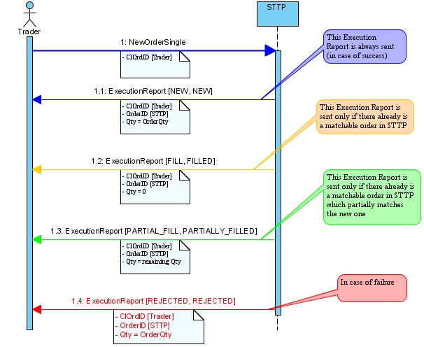
3.1.1 Passive Order
UseCase14_NewPassiveOrder.java

Slide 19
3.1.1 Sending a Passive Order
NewOrderSingle message contains:
ClOrdID
OrderType = Limit
TimeinForce = Good Till Day, Good Till Cancel…
Price
Qty
Side
Code sample:
ExecutionReport message contains:
OrderID
ClOrdID
QuoteID
Price
Quantity
Side
CounterPart
CounterPartClientName
public void sendNewOrderSingle() {
// we create an order
final NewOrderSingle myOrder = STMessageFactory.newNewOrderSingle(instrument);
// we setup the OrderType
myOrder.setOrdType(OrdType.Limit());
myOrder.setTimeInForce(TimeInForce.GTD());
// we assign order properties
myOrder.setSide(Side.BUY());
myOrder.setClOrdID(ClientOrderID.createClientOrderID(UID.next()));
myOrder.setPrice(Price.createPrice("3.6"));
myOrder.setOrderQty(Quantity.createQuantity("10000"));
myOrder.getMessageRouting().setSenderSubID(userID);
// we send
stconnect.sendNewOrderSingle(myOrder);
}

Slide 20
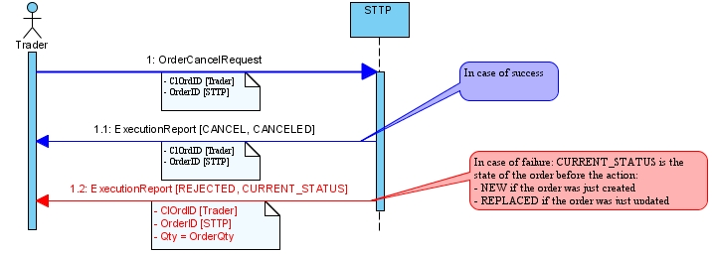
3.1.2 Cancelling Order
UseCase15_CancelOrder.java

Slide 21
3.1.2 Cancelling Order
OrderCancelRequest message contains:
ClOrdID
OrderID
Reason (text field)
Code sample:
public void sendCancelOrderRequest() {
// we create the OrderCancelRequest
final OrderCancelRequest ocr = STMessageFactory.newOrderCancelRequest(instrument);
ocr.setClOrdID(ClientOrderID.createClientOrderID(UID.next()));
ocr.setOrderID(orderID);
ocr.setText("I changed my mind!");
ocr.getMessageRouting().setSenderSubID(userID);
stconnect.sendOrderCancelRequest(ocr);
}

Slide 22
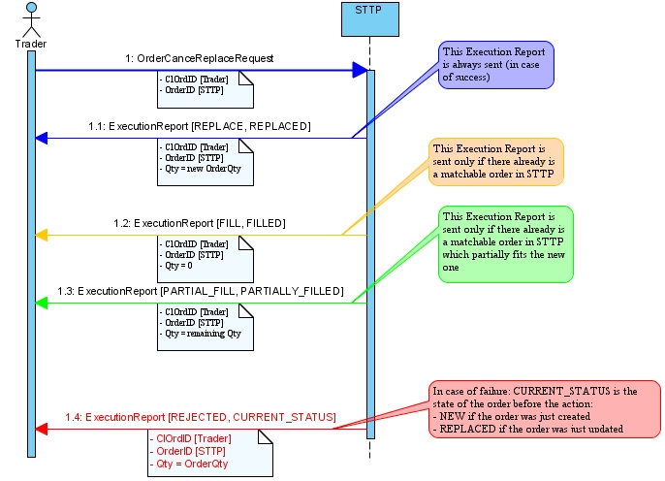
3.1.3 Updating Order
UseCase16_UpdateOrder.java

Slide 23
3.1.3 Updating Order
OrderCancelReplaceRequest message contains:
ClOrdID
OrderID
Reason (text field)
New Price
New Quantity
Code sample:
public void sendOrderCancelReplaceRequest() {
// We create the OrderCancelReplace request
final OrderCancelReplaceRequest occr = STMessageFactory.newOrderCancelReplaceRequest(instrument);
occr.setClOrdID(ClientOrderID.createClientOrderID(UID.next()));
occr.setOrderID(orderID);
occr.setPrice(Price.createPrice("3.8"));
occr.setOrderQty(Quantity.createQuantity("10000"));
occr.setTimeInForce(TimeInForce.GTC());
occr.setOrdType(OrdType.Limit());
occr.setText("Raising price");
occr.getMessageRouting().setSenderSubID(userID);
stconnect.sendOrderCancelReplaceRequest(occr);
}

Slide 24
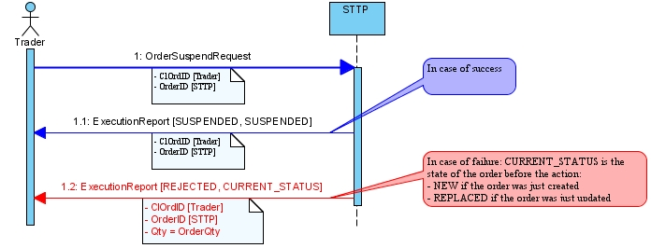
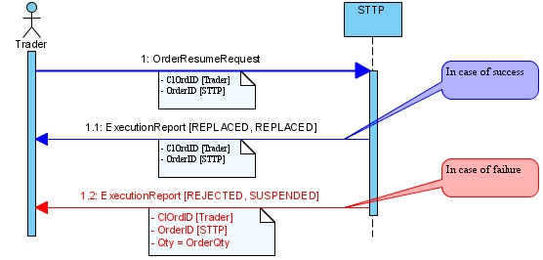
3.1.4 Suspending/Resuming an Order

Slide 25
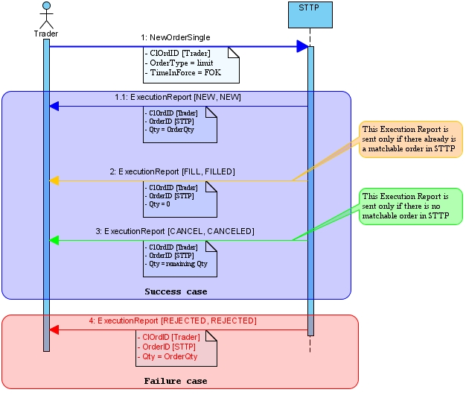
3.2 Hit and Take: sending an order
UseCase9_NewFOKOrder.java

Slide 26
3.2 Hit Take: sending an order
NewOrderSingle message contains:
ClOrdID
OrderType = Limit
TimeinForce = Fill Or Kill
Price
Qty
Side
Code sample:
public void sendNewOrderSingle() {
// we create an order
final NewOrderSingle myOrder = STMessageFactory.newNewOrderSingle(instrument);
// we setup the OrderType
myOrder.setOrdType(OrdType.Limit());
myOrder.setTimeInForce(TimeInForce.FOK());
// we assign order properties
myOrder.setSide(Side.BUY());
myOrder.setClOrdID(ClientOrderID.createClientOrderID("id1"));
myOrder.setPrice(Price.createPrice("3.6"));
myOrder.setOrderQty(Quantity.createQuantity("10000"));
myOrder.getMessageRouting().setSenderSubID(userID);
// we send
stconnect.sendNewOrderSingle(myOrder);
}

Slide 27
4. Queries
Querying smartTrade data
Retrieving Trades List
Retrieving Orders List
Retrieving Instruments List

Slide 28
4.1 Querying smartTrade data
Asynchronous queries
Domain specific query language (STQL)
Usage
Trades
Orders
Securities
Users
UseCase10_TradeListRequest.java

Slide 29
4.1 smartTrade Query Language (STQL)
SQL-like language
More powerful than regular expressions
Fully specified grammar (BNF available)
Compiler available for integration purpose
E.g.
"find trade t where t.counterpartBuyerName=='User 2' ;“
"find order o where o.stlmtDate>=‘2009-03-12’ and o.side=='BUY' ;"
UseCase10_TradeListRequest.java

Slide 30
4.1 smartTrade Query Language (STQL)
BNF for STQL
Query::=Selection
Selection::=<FIND> SelectionType SelectionInstance ( <WHERE> SelectionCondition )? ";«
SelectionType::=( ( <ORDER> ) | ( <INSTRUMENT> ) | ( <USER> ) | ( <USERGROUP> ) | ( <TRADE> ) | ( <AGG_TRADE> ) | ( <NEGOTIATION> ) | ( <NEGOTIATION_AUDIT_TRACK> ) | ( <INSTRUMENT_CLASS> ) )
SelectionInstance::=( <IDENTIFIER> )
SelectionCondition::=( BoolExpression )
BoolExpression::=( ComparisonExpression ) ( BoolExpressionTerm )*
BoolExpressionTerm::=( <AND> | <OR> ) ComparisonExpression
ComparisonExpression::=( UnaryExpression ) ( ( <EQUAL> | <NOTEQUAL> | <GT> | <LT> | <GEQ> | <LEQ> ) UnaryExpression )?
UnaryExpression::=( UnaryBoolExpression | Literal | Field | Variable )
Literal::=( ( <STRING_LITERAL> ) | ( <INTEGER_LITERAL> ) | ( <FLOAT_LITERAL> ) | ( <DATETIME_LITERAL> ) )
UnaryBoolExpression::=( ( ( "(" ) BoolExpression ")" ) | ( <TRUE> ) | ( <FALSE> ) )
Field::=SelectionInstance <FIELDNAME>
Variable::=( <IDENTIFIER> )

Slide 31
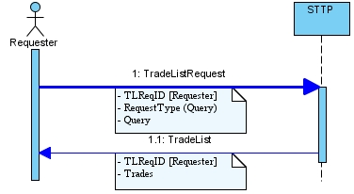
4.2 Trades: getting the trades list
From Requester to STTP
TradelistRequest message containing:
TLReqID
RequestType (query)
STQL Query
From STTP to Requester
TradeList message containing:
TLReqID
Trades
UseCase10_TradeListRequest.java

Slide 32
4.2 TradeListRequest & TradeList Messages
TradeListRequest message:
TradeList message:
void sendTradeListRequest() {
// Creating a trade list request
final TradeListRequest tradeListRequest = STMessageFactory.newTradeListRequest(TradeListRequestType.TRD_BY_QUERY(), TLReqID
.createTLReqID(UID.next()));
// Setting the query for the selection
final Query query = Query.createQuery("find trade t where true;");
tradeListRequest.setQuery(query);
// Setting sender information
tradeListRequest.getMessageRouting().setSenderSubID(userID);
// Limiting information quantity
tradeListRequest.setFetchInstrument(false);
tradeListRequest.setFetchUser(false);
// Sending the request
stconnect.sendTradeListRequest(tradeListRequest);
}
@Override
public void onTradeList(TradeList message) {
// TradeList is a message sent by STTP containing the list of all realized trades
System.out.println("onTradeList");
System.out.println(message);
}

Slide 33

4.3 Orders: getting the orders list
From Requester to STTP
OrderlistRequest message containing:
OLReqID
RequestType (query)
STQL Query
From STTP to Requester
OrderList message containing:
OLReqID
Orders
UseCase11_OrderListRequest.java

Slide 34
4.3 OrderListRequest & OrderList Messages
OrderListRequest message:
OrderList message:
void sendOrderListRequest() {
// Creating a order list request
final OrderListRequest orderListRequest = STMessageFactory.newOrderListRequest(OrderListRequestType.ORD_BY_QUERY(), OLReqID
.createOLReqID(UID.next()));
// Setting the query for the selection
final Query query = Query.createQuery("find order o where true;");
orderListRequest.setQuery(query);
// Setting sender information
orderListRequest.getMessageRouting().setSenderSubID(userID);
// Limiting information quantity
orderListRequest.setFetchInstrument(false);
orderListRequest.setFetchUser(false);
// Sending the request
stconnect.sendOrderListRequest(orderListRequest);
}
@Override
public void onOrderList(OrderList message) {
log.info("onOrderList");
log.info(message);
}

Slide 35

4.4 Instruments: getting the securities list
From Requester to STTP
SecuritylistRequest message containing:
SLReqID
RequestType (query)
STQL Query
From STTP to Requester
SecurityList message containing:
SLReqID
Securities
UseCase12_SecurityListRequest.java

Slide 36
4.4 InstrumentListRequest & InstrumentList Messages
InstrumentListRequest message:
InstrumentList message:
void sendSecurityListRequest() {
// Creating a security list request
final SecurityListRequest tradeListRequest = STMessageFactory.newSecurityListRequest(SecurityListRequestType.SL_BY_QUERY(),
SLReqID.createSLReqID(UID.next()));
// Setting the query for the selection
final Query query = Query.createQuery("find instrument i where i.securityClassName=='Deposit';");
tradeListRequest.setQuery(query);
// Setting sender information
tradeListRequest.getMessageRouting().setSenderSubID(userID);
// Sending the request
stconnect.sendSecurityListRequest(tradeListRequest);
}
@Override
public void onSecurityList(SecurityList message) {
log.info("onSecurityList");
log.info(message);
}

Slide 37
5. Request For Quote
Workflow & Messages
Requester Actions
Sending a RFQ
Updating a RFQ
Cancelling a RFQ
Executing a RFQ
Other Events
Receiving a quote
Receiving a quoter execution
Receiving RFQ cancellation
Expirations

Slide 38
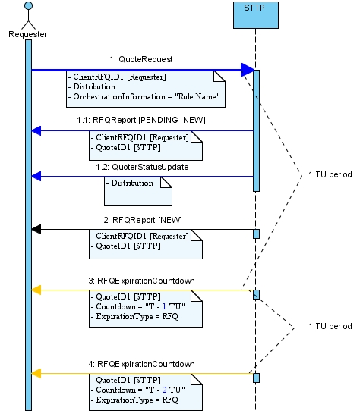
5.1 Requester Action workflow: sending a RFQ
UseCase3_SendRFQ.java

Slide 39
5.1 QuoteRequest & RFQReport messages
QuoteRequest message:
From Requester to STTP
Contains:
ClientRFQID
Proposed Bid/Offer
Price
Quantity
Timeout
ClientName
OrchestrationInformation
Custom Fields
RFQReport message:
From STTP to Requester
Contains:
ClientRFQID
QuoteID
RFQStatus:
NEW/PENDING_NEW…
RFQExecType
OK, KO

Slide 40
5.1 Send QuoteRequest sample code
public void sendBidRFQ() {
log.info("Sending RFQ");
final QuoteRequest rfq = STMessageFactory.newQuoteRequest(instrument);
// Creating a unique ID
final ClientRFQID clientRFQID = ClientRFQID.createClientRFQID(UID.next());
rfq.setClientRFQID(clientRFQID);
// Creating a bid entry
final MarketDataEntry bidEntry = STMessageFactory.newMarketDataEntry(Quantity.createQuantity("100"), Price.ZERO, false);
rfq.setProposedBid(bidEntry);
// Creating an empty offer entry
final MarketDataEntry offerEntry = STMessageFactory.newMarketDataEntry(Quantity.ZERO, Price.ZERO, true);
rfq.setProposedOffer(offerEntry);
// Setting the timeout at 120 secs
rfq.setTimeOut(TimeOut.createTimeOut(120000));
// Setting Client name
rfq.setClientName("My Client");
// Setting the rule to use for the Routing
// final OrchestrationInformation information = STMessageFactory.newOrchestrationInformation(“My RFQ Routing Rule");
// rfq.setOrchestrationInformation(information);
// Adding custom fields
rfq.setCustomField("CustFirm", "Smart Trade");
// Setting the sender's ID
rfq.getMessageRouting().setSenderSubID(userID);
// Sending the RFQ
stconnect.sendQuoteRequest(rfq);
}
Workflow & Messages
Requester Actions
Sending a RFQ
Updating a RFQ
Cancelling a RFQ
Executing a RFQ
Other Actions
Quotes from Quoters
Expirations

Slide 41
5.1 Receiving a RFQReport
@Override
public void onRFQReport(RFQReport message) {
// RFQReport is acknowledgement message sent by STTP on RFQ
log.info("onRFQReport");
log.info(message);
// we can store the QuoteID: identifier of the RFQ serverside
quoteID = message.getQuoteID();
}

Slide 42
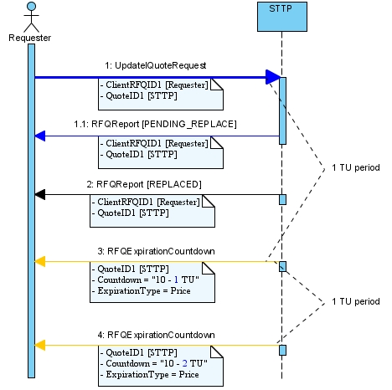
5.1 Requester Action workflow: updating a RFQ
UpdateQuoteRequest message:
From Requester to STTP
Contains:
ClientRFQID
QuoteID
New Proposed Bid/Offer
Price
Quantity
New Price Timeout (10 secs)
UseCase4_UpdateRFQ.java

Slide 43
5.1 Updating QuoteRequest sample code
void sendUpdateRFQ() {
log.info("Updating RFQ");
final UpdateQuoteRequest uqr = STMessageFactory.newUpdateQuoteRequest(instrument);
// Creating an ID
final ClientRFQID clientRFQID = ClientRFQID.createClientRFQID(UID.next());
uqr.setClientRFQID(clientRFQID);
// Setting the quoteId of the RFQ
uqr.setQuoteID(quoteID);
// Updating a bid entry
final MarketDataEntry bidEntry = STMessageFactory.newMarketDataEntry(Quantity.createQuantity("100"), Price.createPrice("150"),
false);
uqr.setProposedBid(bidEntry);
// Creating an empty offer entry
final MarketDataEntry offerEntry = STMessageFactory.newMarketDataEntry(Quantity.ZERO, Price.ZERO, true);
uqr.setProposedOffer(offerEntry);
// Setting the timeout at 10 secs
uqr.setProposedPriceTimeOut(TimeOut.createTimeOut(10000));
// Setting the sender's ID
uqr.getMessageRouting().setSenderSubID(userID);
// Updating the RFQ
stconnect.sendUpdateQuoteRequest(uqr);
}

Slide 44
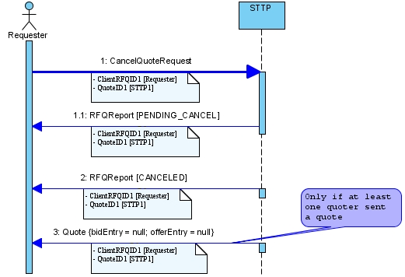
5.1 Requester Action workflow: cancelling a RFQ
CancelQuoteRequest message:
From Requester to STTP
Contains:
ClientRFQID
QuoteID
UseCase5_CancelRFQ.java

Slide 45
5.1 Cancelling QuoteRequest sample code
void sendCancelRFQ() {
log.info("Cancelling RFQ");
final CancelQuoteRequest cqr = STMessageFactory.newCancelQuoteRequest(instrument);
// Creating an ID
final ClientRFQID clientRFQID = ClientRFQID.createClientRFQID(UID.next());
cqr.setClientRFQID(clientRFQID);
// Setting the quoteId
cqr.setQuoteID(quoteID);
// Setting the sender's ID
cqr.getMessageRouting().setSenderSubID(userID);
// Cancelling the RFQ
stconnect.sendCancelQuoteRequest(cqr);
}

Slide 46
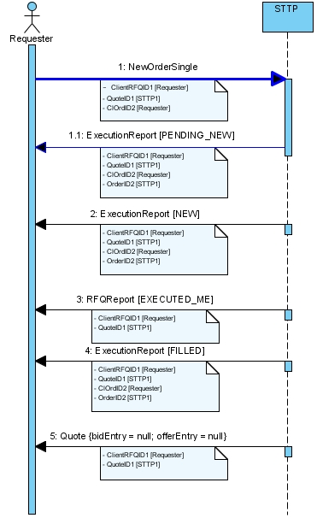
5.1 Requester Action workflow: executing a RFQ
NewOrderSingle message:
From Requester to STTP
Appears only after a quote
Contains:
ClientRFQID
QuoteID
ClOrdID
Price
Quantity
Side
UseCase6_ExecuteRFQ.java

Slide 47
5.1 Executing QuoteRequest sample code
public void sendNewOrderSingle() {
log.info("Sending Order");
// we create an order
final NewOrderSingle myOrder = STMessageFactory.newNewOrderSingle(instrument);
// we assign RFQ properties
myOrder.setQuoteID(quoteID);
// we assign order properties
myOrder.setSide(Side.SELL());
myOrder.setClOrdID(ClientOrderID.createClientOrderID(UID.next()));
// price and quantity must be identical to the quote
myOrder.setPrice(Price.createPrice("10"));
myOrder.setOrderQty(Quantity.createQuantity("100"));
myOrder.getMessageRouting().setSenderSubID(userID);
// we send
stconnect.sendNewOrderSingle(myOrder);
}

Slide 48
5.1 Execution Report & Expiration Messages
ExecutionReport message:
From STTP to Requester
Contains:
OrderID
ClOrdID
QuoteID
Price
Quantity
Side
CounterPart
CounterPartClientName
RFQExpirationCountdown
From STTP to Requester
Contains:
QuoteID
Countdown
ExpirationType
RFQ
Price

Slide 49
5.1 Receiving ExecutionReport & RFQExpirationCoundown
ExecutionReport message:
RFQExpirationCountdown message
@Override
public void onExecutionReport(ExecutionReport message) {
// ExecutionReport is acknowledgement message sent by STTP on Orders
System.out.println("onExecutionReport");
System.out.println(message);
}
@Override
public void onRFQExpirationCountdown(RFQExpirationCountdown message) {
// RFQExpirationCountdown is a timer message sent by STTP each second
System.out.println("onRFQExecutionCountdown");
System.out.println(message);
}

Slide 50
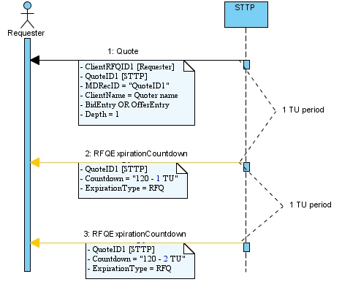
5.2 Other events: Receiving a quote
Quote message:
From STTP to Requester (on behalf of a quoter)
Contains:
ClientRFQID
QuoteID
Timeout
MarketDataSnapshot:
Aggregated Bid/Offer entry
Price
Quantity
UseCase7_QuoterEvents.java

Slide 51
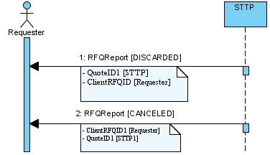
5.2 Other events: Receiving RFQ cancellation
2 RFQReport messages:
From STTP to Requester
Both containing:
ClientRFQID
QuoteID
N°1: RFQStatus DISCARDED
N°2: RFQStatus CANCELED

Slide 52
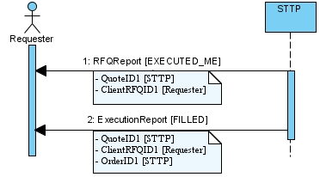
5.2 Other events: Receiving RFQ execution
RFQReport message containing:
ClientRFQID
QuoteID
RFQStatus EXECUTED_ME
RFQReport message containing:
QuoteID
ClientRFQID
OrderID
OrdStatus FILLED
UseCase8_QuoterExecution.java

Slide 53
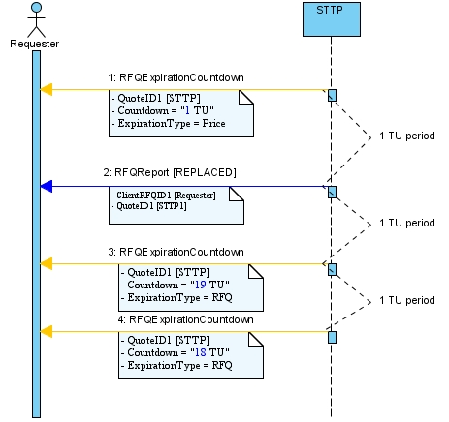
5.2 Other events: Requester’s Price expires
RFQReport message containing:
ClientRFQID
QuoteID
RFQStatus REPLACED
RFQ ExecType: PRICE_EXPIRED

Slide 54
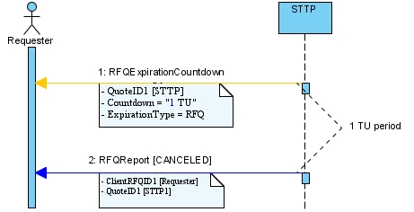
5.2 Other events: RFQ expires
RFQReport message containing:
ClientRFQID
QuoteID
RFQStatus CANCELED

Slide 55
6. Failover
Features
Workflow
Message : Node Status Report

Slide 56
6.1 Failover features
Failover strategies to be defined based on the functional needs
Heartbeats exchanged between the client and the servers
Detection of connectivity lost => action to be done when the client gets disconnected
Detection of readiness of the servers
Action to be done
Notification that a backup server becomes active
Need to switch to the new node
Actions to be executed (market data registration)

Slide 57
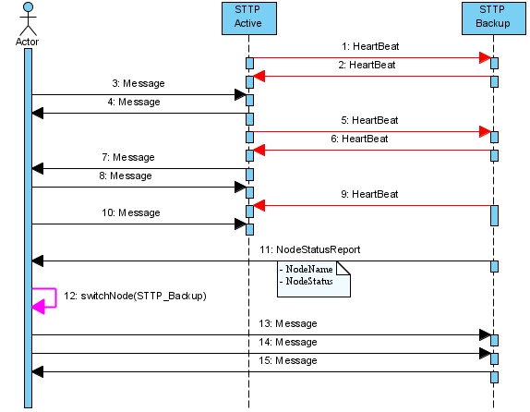
6.2 Failover workflows
UseCase11_Failover.java

Slide 58
6.3 Failover message: NodeStatusReport
Sent when a new node becomes active or on request
When a NodeStatusRequest is sent, all the node respond with a NodeStatus Report
A NodeStatusReport contains
The partition node name
The node status (active/inactive)
STConnect has to switch to the new node using the
com.smarttrade.connect.routed.STConnect.switchNode(String partitionName) method
The client needs to know the topology to associate the partition node name to the partition name

Slide 59
6.3 Failover message: NodeStatusReport code sample
@Override
public void onNodeStatusReport(NodeStatusReport message) {
log.info("onNodeStatusReport" + message);
if (message.getNodeName().endsWith("B") && message.getNodeStatus().equals(NodeStatus.SERVER_IS_ACTIVE())) {
if (message.getNodeName().startsWith("M1")) {
stconnect.switchNode("M1"); //need to tell STConnect to switch to the backupnode
log.info("Need to resubscribe to MDS for parition M1");
subscribeToMarketData("M1"); //need to subscribe to the MarketData on the BackupNode
} else if (message.getNodeName().startsWith("M2")) {
stconnect.switchNode("M2"); //need to tell STConnect to switch to the backupnode
log.info("Need to resubscribe to MDS for parition M2");
subscribeToMarketData("M2"); //need to subscribe to the MarketData on BackupNode
}
}
}

